Slide 1
Deep Learning
Fundamentals and math part 1
Chapter 2
Vera Hollink
2025

Slide 2
Recap Week 1
What is deep learning?

Slide 3

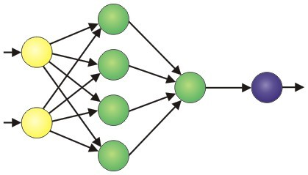
Brain

Slide 4


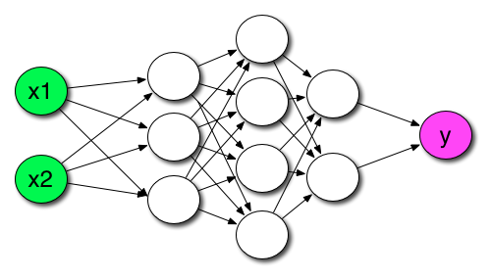
Neural netwerk

Slide 5
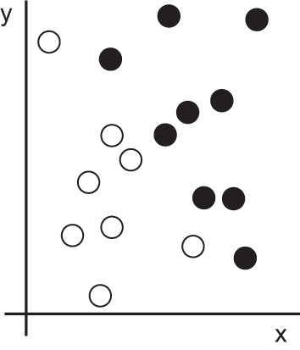
Task: separate black and white dots

Slide 6
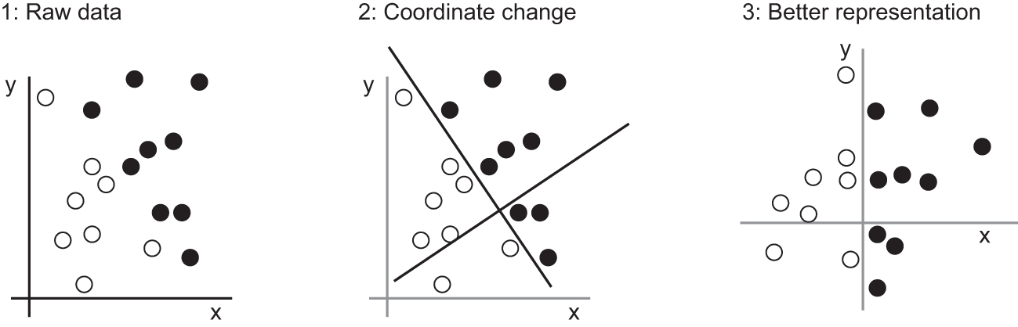
Transform input to facilitate classification
Separate dots:
x > 0 ➔ black

Slide 7
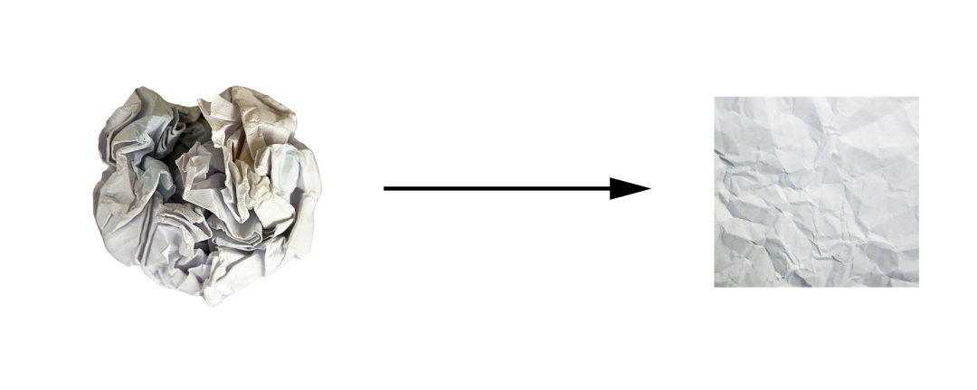
Transform input to facilitate classification

Slide 8
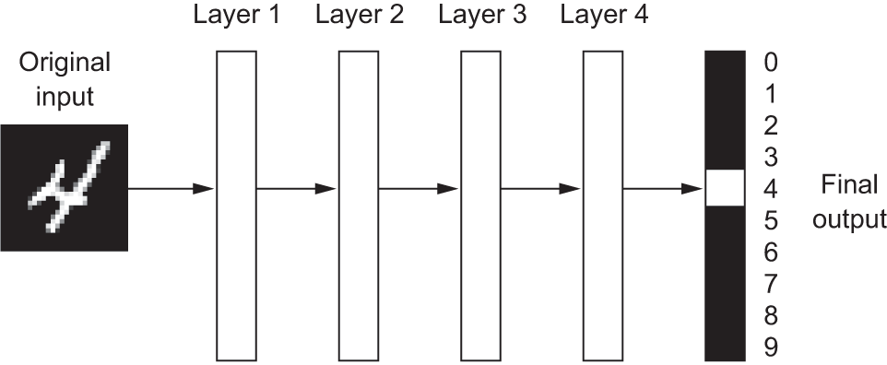
Neural network

Slide 9
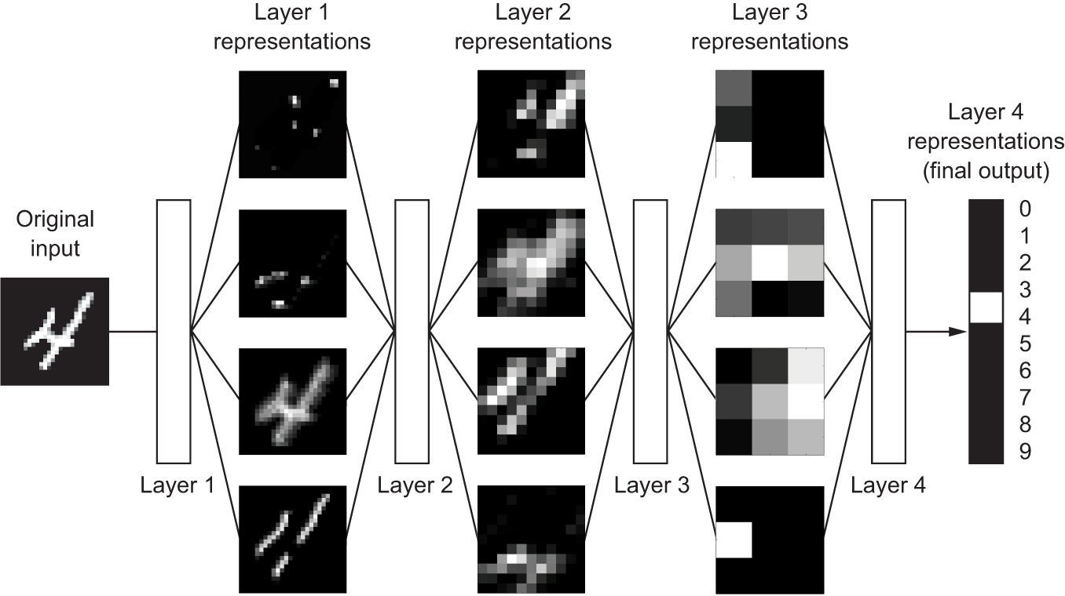
Neural network

Slide 10
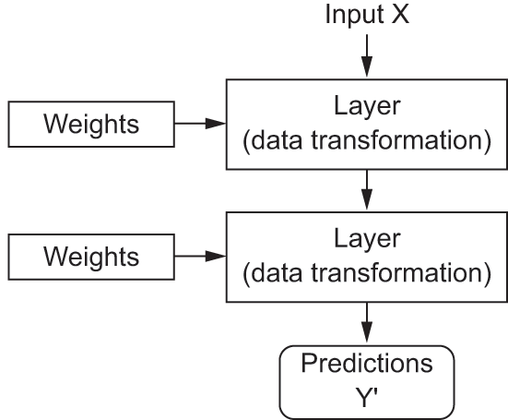
Predicting with a NN

Slide 11
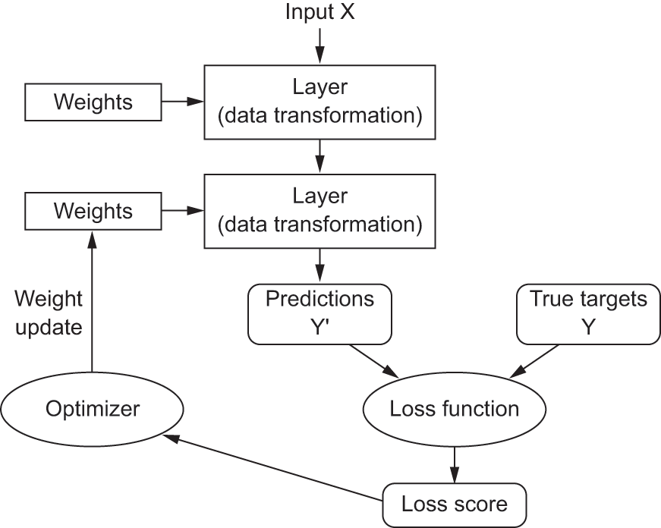
Training a NN: finding the right values for the weights

Slide 12
Using a Neural Net for Prediction: forward propagation

Slide 13
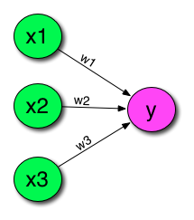
Perceptron

Slide 14
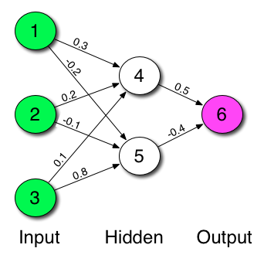
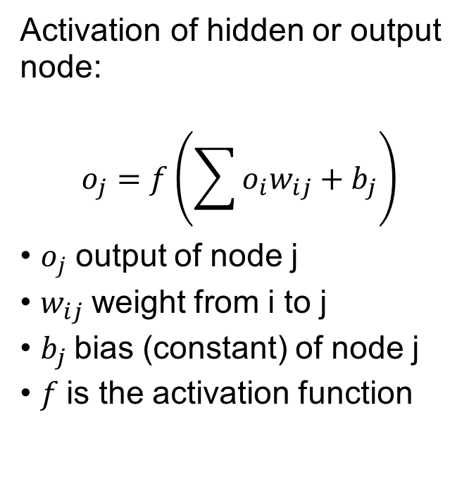
NN with hidden layer: forward propagation
Activation of hidden or output node:
$$o_{j}=f\left(\sum{o_{i}w_{ij}+b_{j}}\right)$$
$o_{j}$ output of node j
$w_{ij}$weight from i to j
$b_{j}$bias (constant) of node j
$f$is the activation function

Slide 15
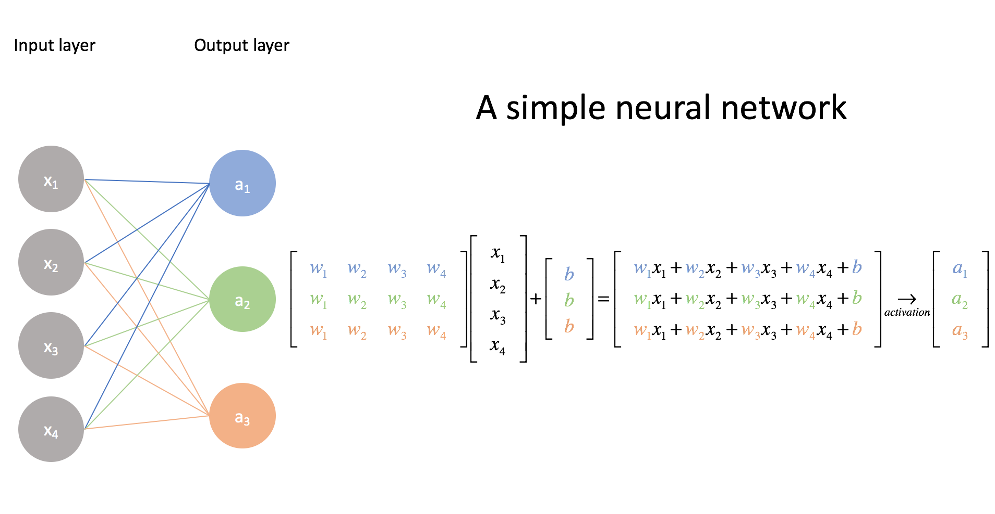
Forward propagation: matrix notation

Slide 16

Forward propagation: matrix notation
$$o_{j}=f\left(\sum{o_{i}w_{ij}+b_{j}}\right)$$
$$output=f\left(input∙W+b\right)$$
$W$ is weight matrix
$b$bias (constant) vector

Slide 17
Data representation
Tensor: generalization of matrix in arbitrary number of dimensions
0 dimension: scalar (number)
1 dimension: vector [1,8,3,2]
2 dimensions: matrix [[1,8,3,2], [1,6,4,2]]
3 dimensions: cube [[[1,2,7], [3,4,2]], [[1,2,4], [3,4,4]]]
4+ dimensions: hypercube

Slide 18

Data representation: batches
Batch: set of (training) samples
Row: sample
Column: attribute

Slide 19
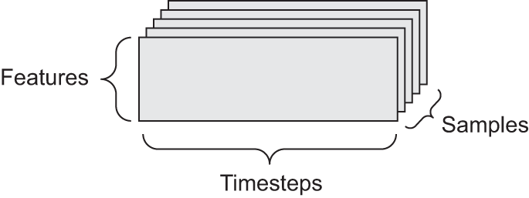
Data representation: types of data sets
2 dimensional: vector data (features)
Samples x features
3 dimensional: sequence/timeseries data
Samples x timestamp x features

Slide 20
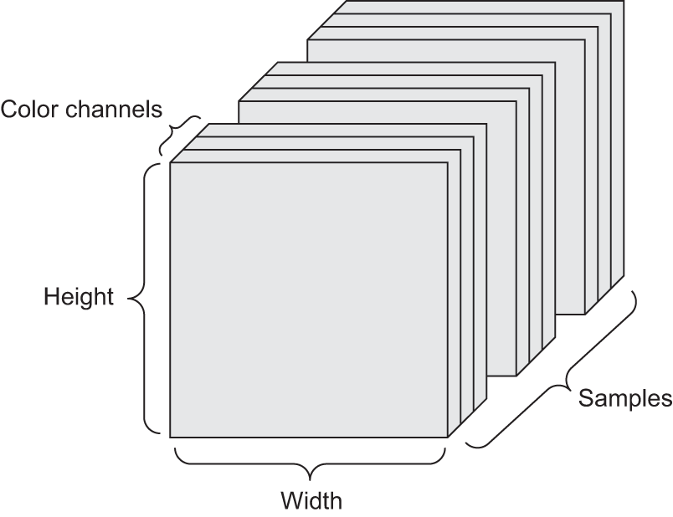
Data representation: types of data sets
4 dimensions: image data
Samples x channels (colors) x height x width
5 dimensions: video data
Samples x frames (timesteps) x channels (colors) x height x width

Slide 21
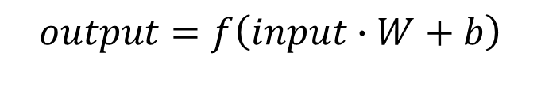
Forward propagation: matrix notation
$$output=f\left(input∙W+b\right)$$
Note: here one sample is a column. Usually it is a row and we use f(input.W+b).

Slide 22
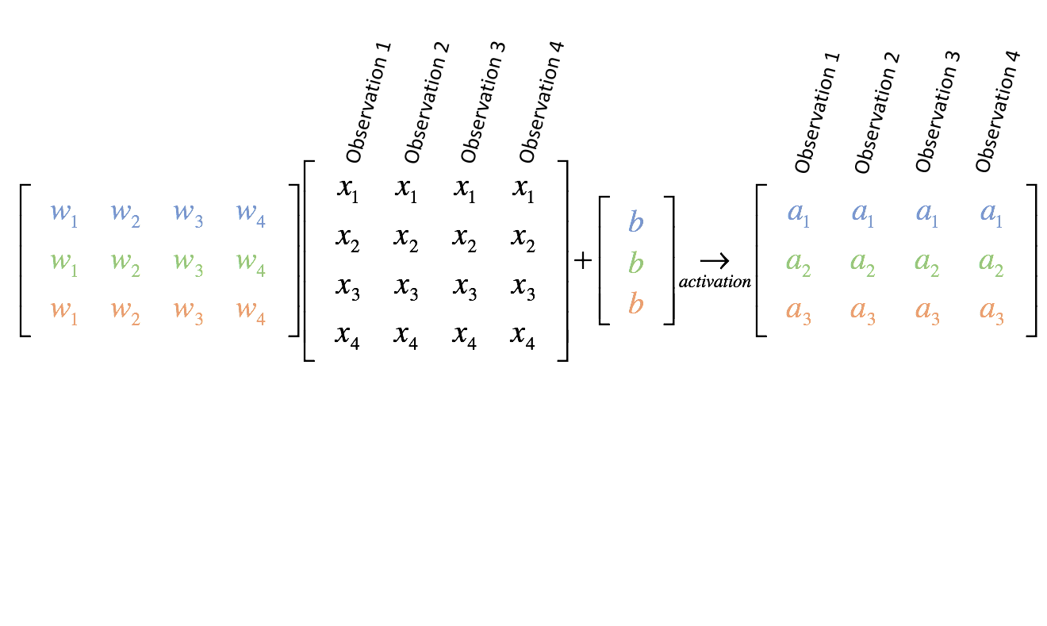
Forward propagation: matrix notation
$$output=f\left(input∙W+b\right)$$
Using multiple samples (observations)
Note: here one sample is a column. Usually it is a row and we use f(input.W+b).

Slide 23

Exercise data representation
Batch: 5000 samples
Inputs: heart rate, blood pressure, temperature, respiration rate, immune activity rate
Output: infection yes/no
Network: 2 hidden layers with 3 nodes each
Exercise:
What are the dimensions of the input data?
What are the dimensions of the output data?
Draw the network as circles and arrows (no weights)
What are the dimensions of the weight matrixes of each of the nodes?

Slide 24
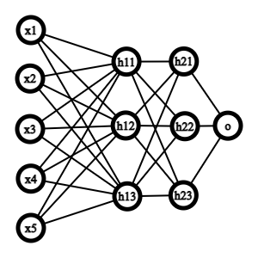
Exercise data representation
Input dimensions: 5000 x 5
Output dimensions: 5000 x 1
Network:

Slide 25
Exercise data representation
Weight matrix dimensions:
first hidden layer: 5 in, 3 out ➔ 5x3 weights and 1x3 bias
second hidden layer 3 in, 3 out ➔ 3x3 weights and 1x3 bias
output layer 3 in, 1 out ➔ 3x1 weights and 1x1 bias
5 rows, 3 columns

Slide 26
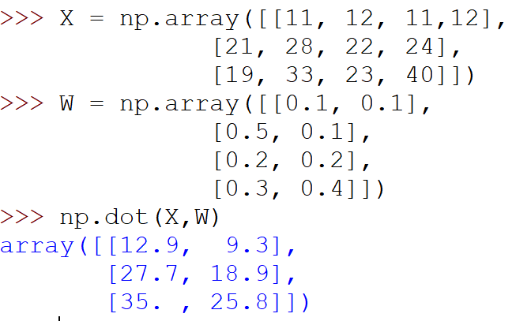
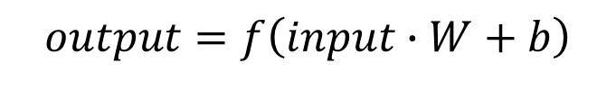
Operations on tensors using numpy
$$output=f\left(input∙W+b\right)$$
Multiply input and weights: inner product

Slide 27
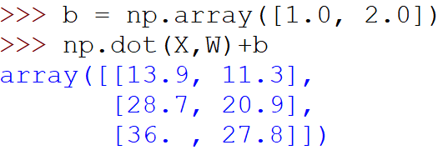
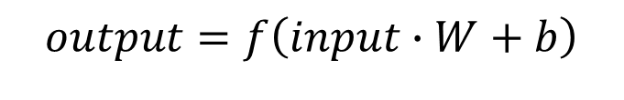
Operations on tensors using numpy
$$output=f\left(input∙W+b\right)$$
Add bias vector
Never implement these operations yourself using loops. Numpy is much faster!

Slide 28
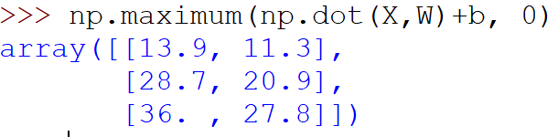
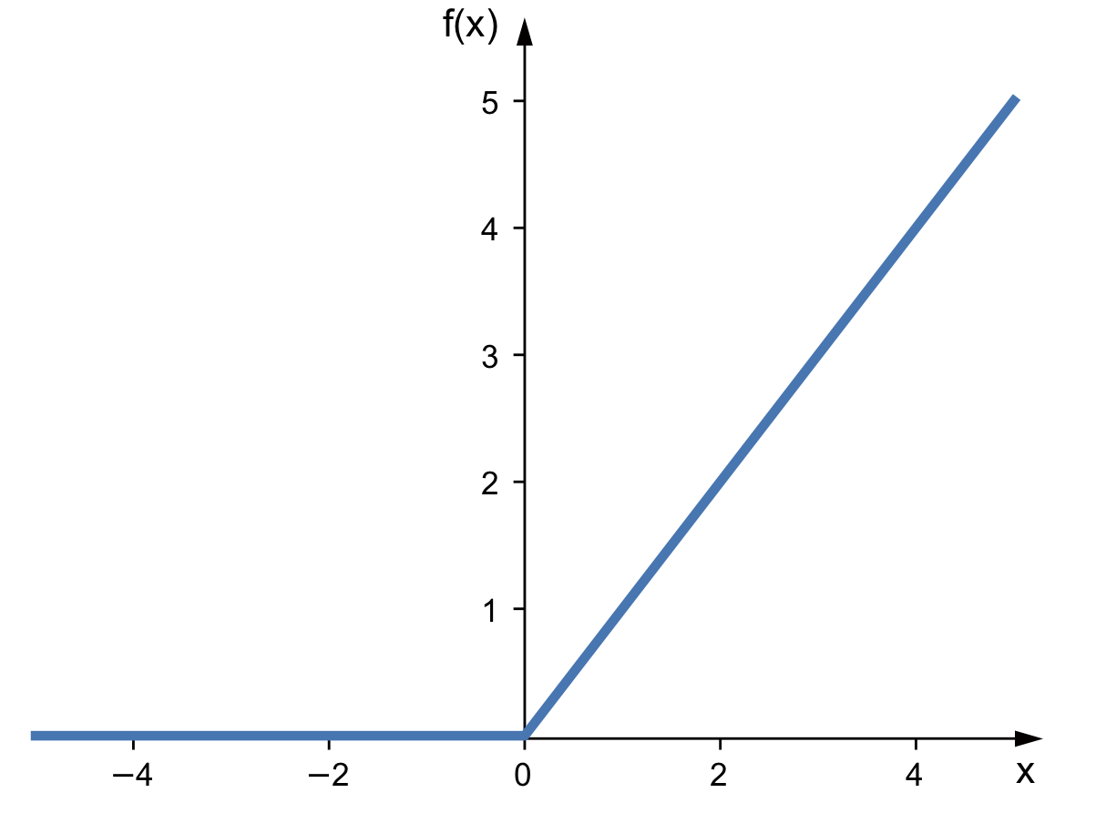

Operations on tensors using numpy
$$output=f\left(input∙W+b\right)$$
Apply activation function f
relu function:
$$relu\left(x\right)=maximum(x, 0)$$

Slide 29
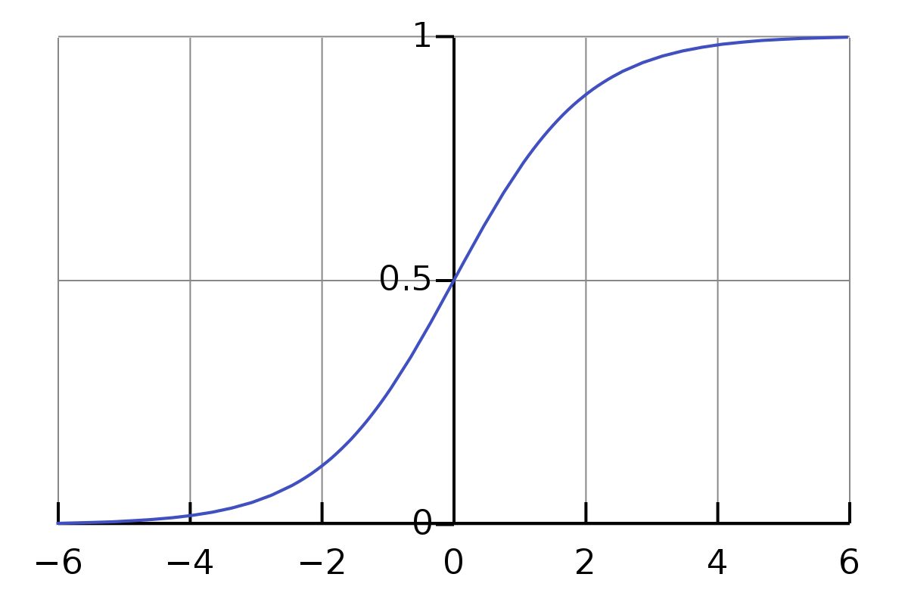

Operations on tensors using numpy
$$output=f\left(input∙W+b\right)$$
Apply activation function f
sigmoid function:
$sigmoid\left(x\right)= \frac{1}{1+e^{−x}}$
>>> 1/(1 + np.exp(-np.dot(X,W)+b))

Slide 30
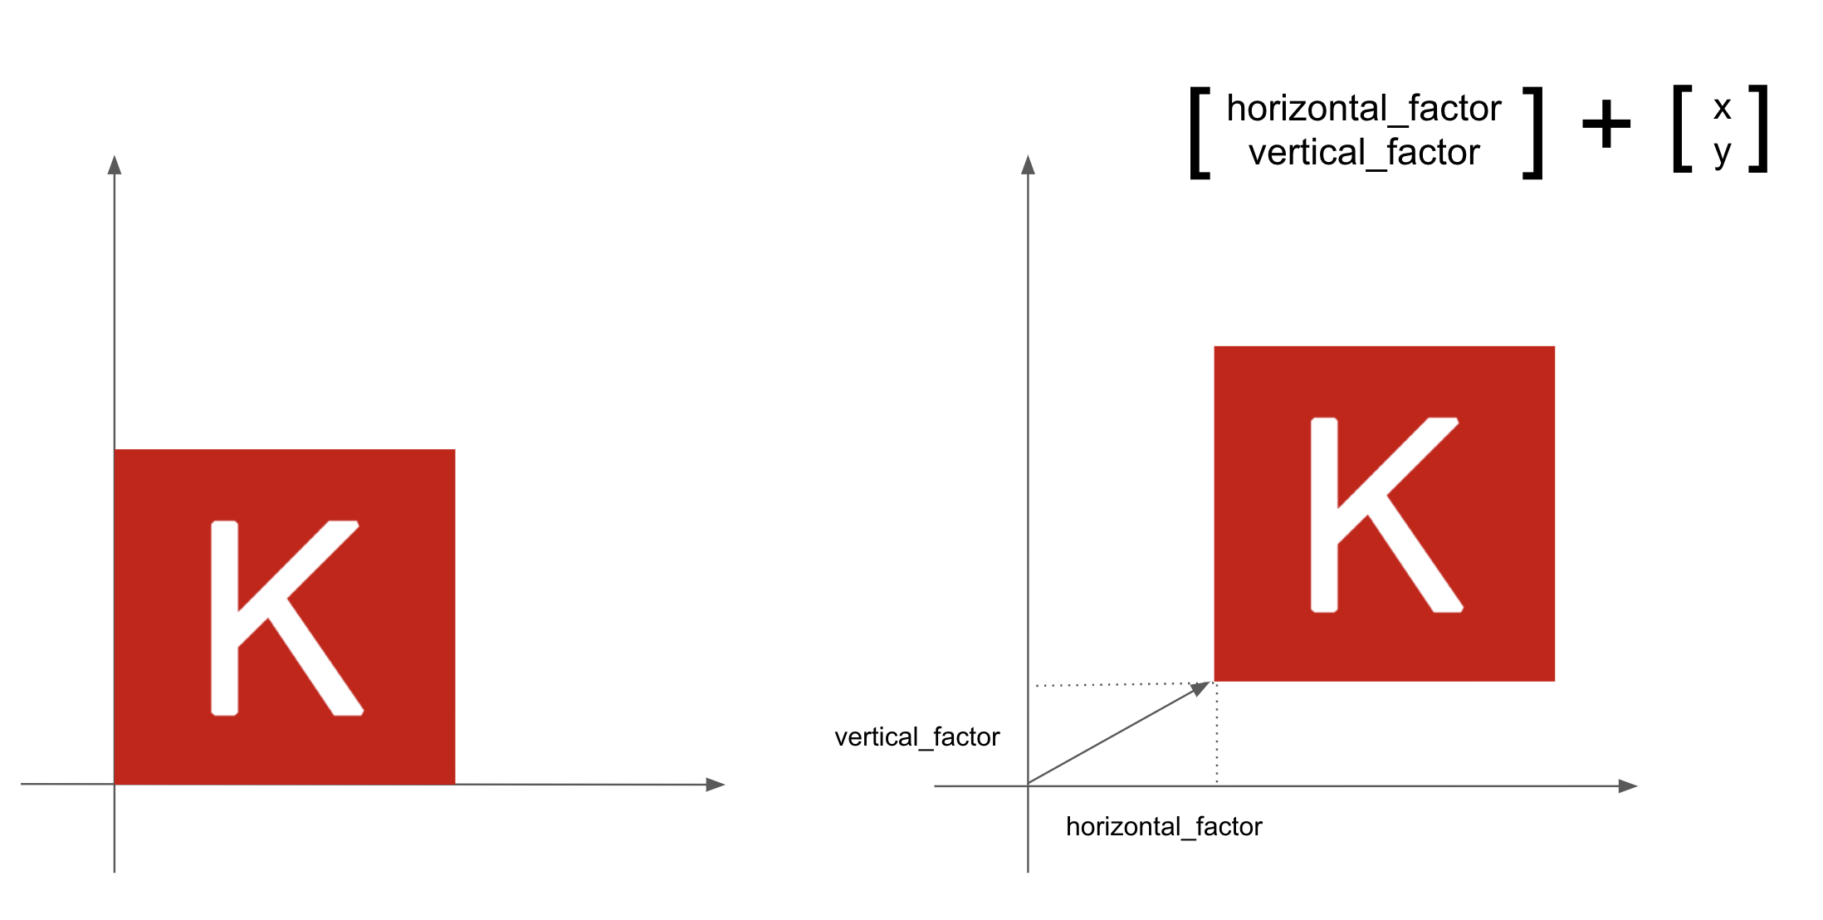
Geometric interpretation of tensor operations
Addition for translation

Slide 31
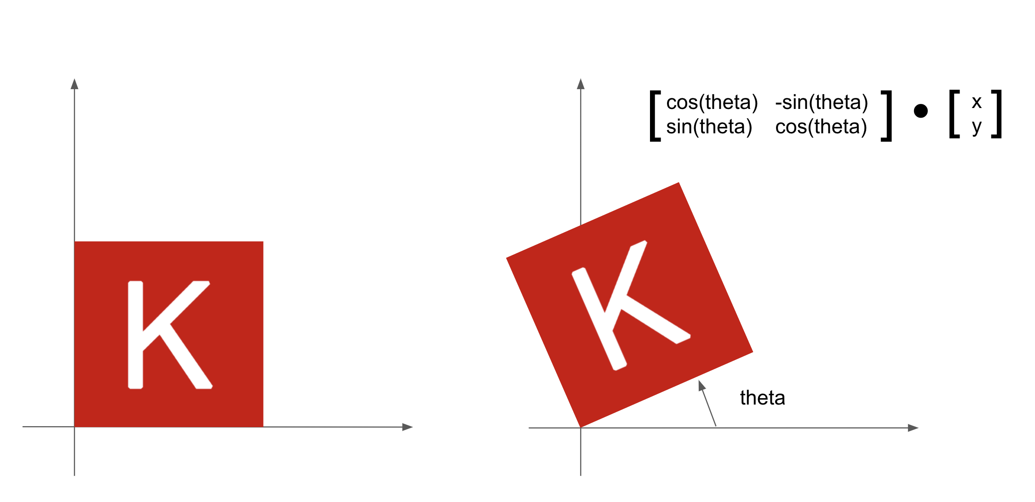
Geometric interpretation of tensor operations
Multiplication for rotation

Slide 32
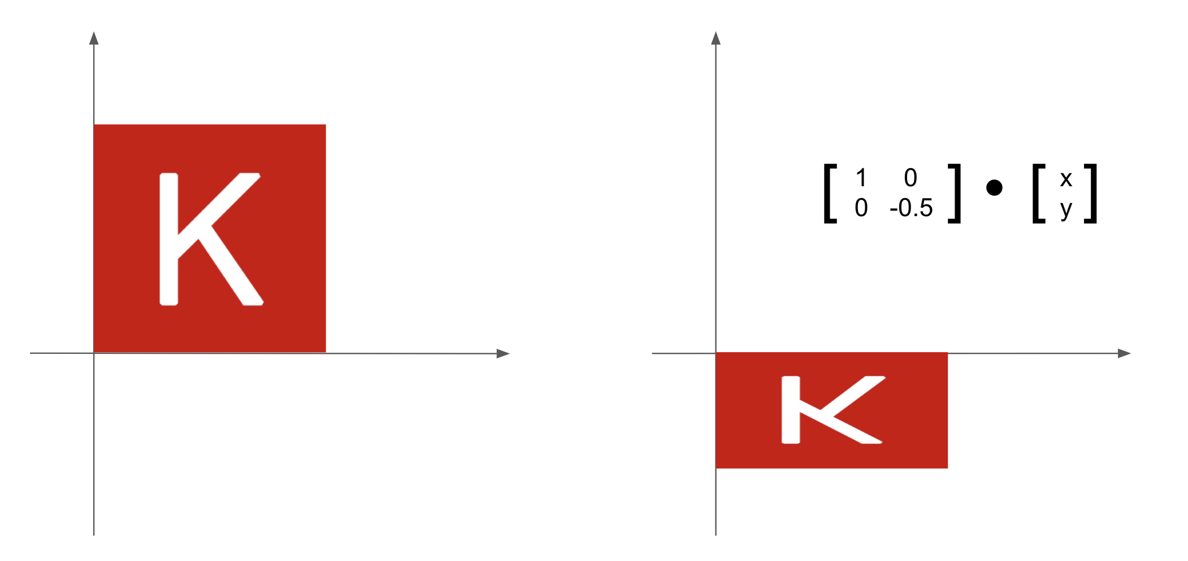
Geometric interpretation of tensor operations
Multiplication for scaling

Slide 33
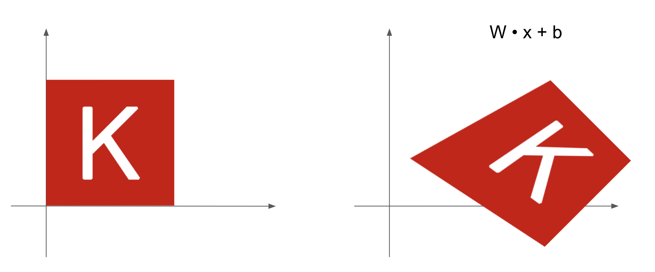
Geometric interpretation of tensor operations
W *X + b for affine transformation

Slide 34
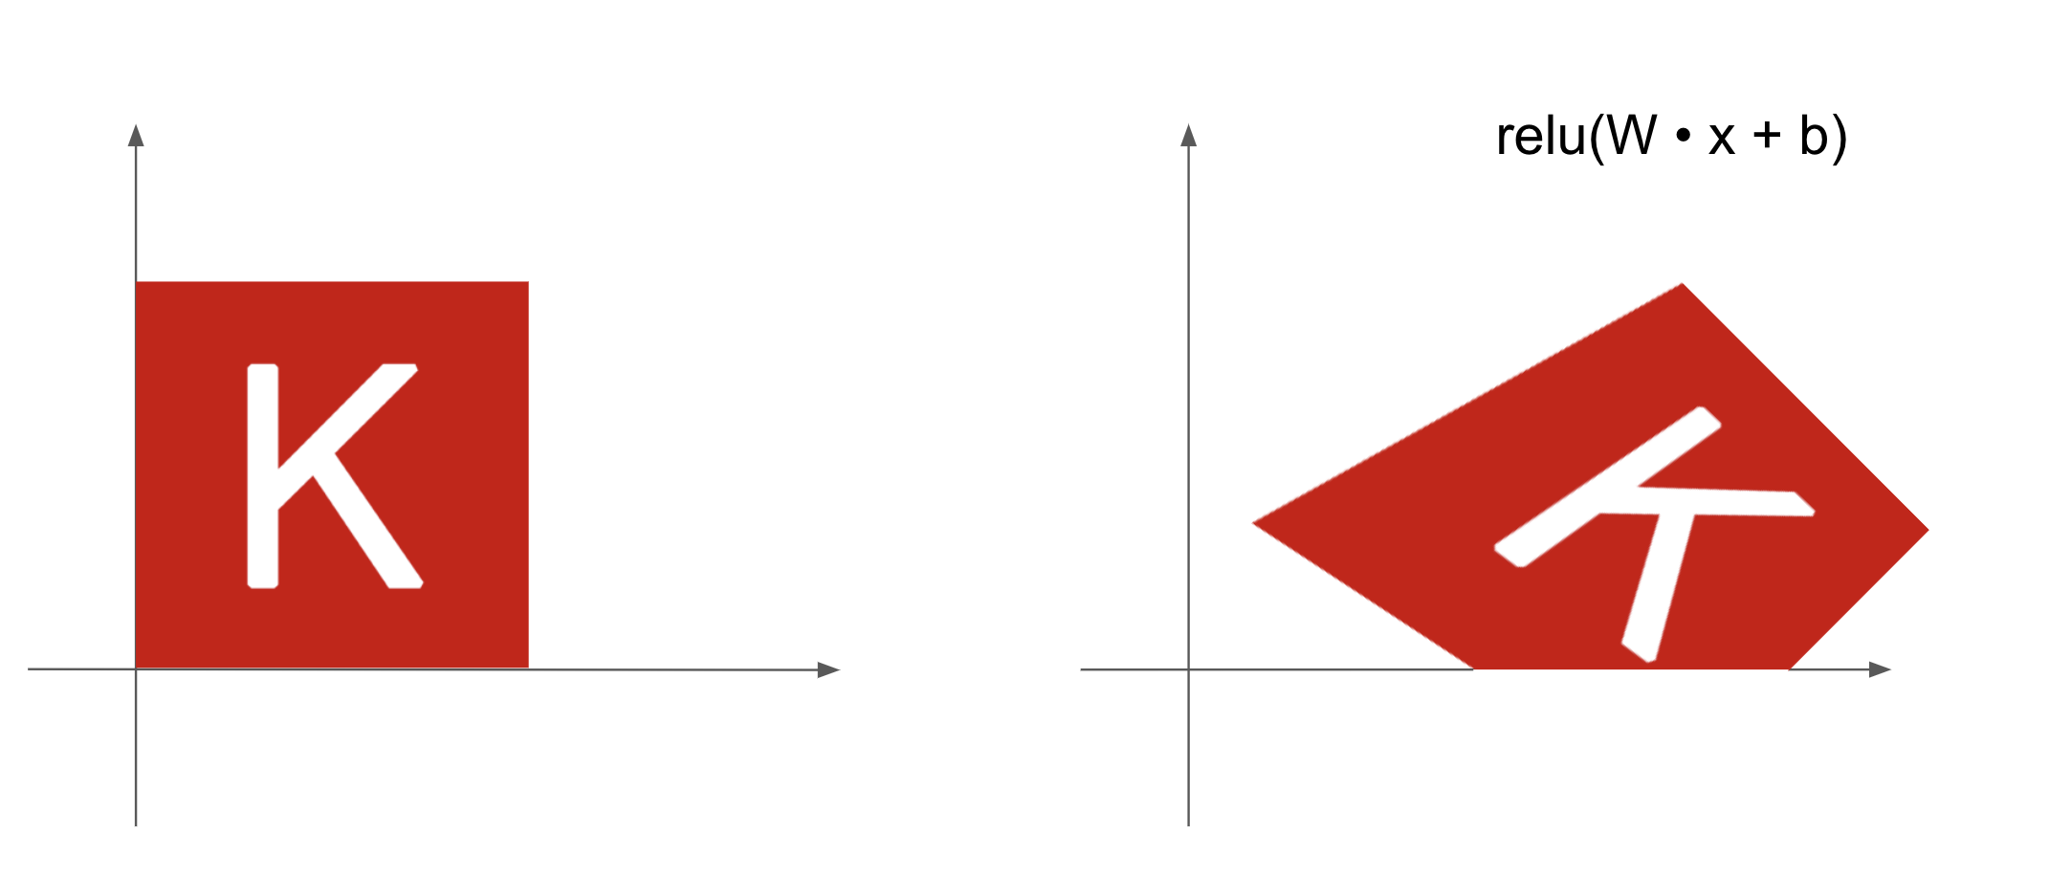
Geometric interpretation of tensor operations
relu(W *X + b)

Slide 35
Combining operations of many layers for complex transformation of the data

Slide 36
Neural network

Slide 37

Exercise forward propagation
Compute the value of the output with the following input:
x₁ = 1.0
x₂ = 1.5
x₃ = 2.0
All bias vectors $b$are 0
All nodes use a relu function:
$output=maximum (W∙input+b, 0)$

Slide 38

Exercise forward propagation
x₁ = 1.0, x₂ = 1.5, x₃ = 2.0
${output}_{4}=maximum \left(0.3∗1.0+0.2∗1.5+0.1∗2.0, 0\right)=0.8$
${output}_{5}=maximum \left(−0.2∗1.0−0.1∗1.5+0.8∗2.0, 0\right)=1.25$
${output}_{6}=maximum \left(0.5∗0.8−0.4∗1.25, 0\right)=0$

Slide 39
Next class: Training a Neural Net

